Slide 1
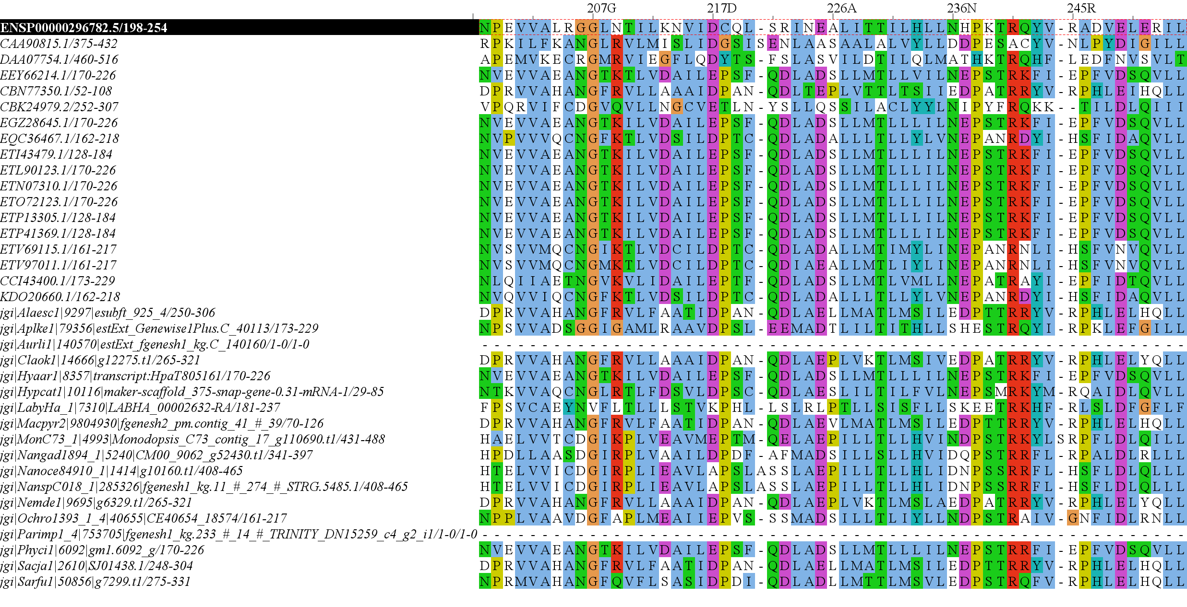
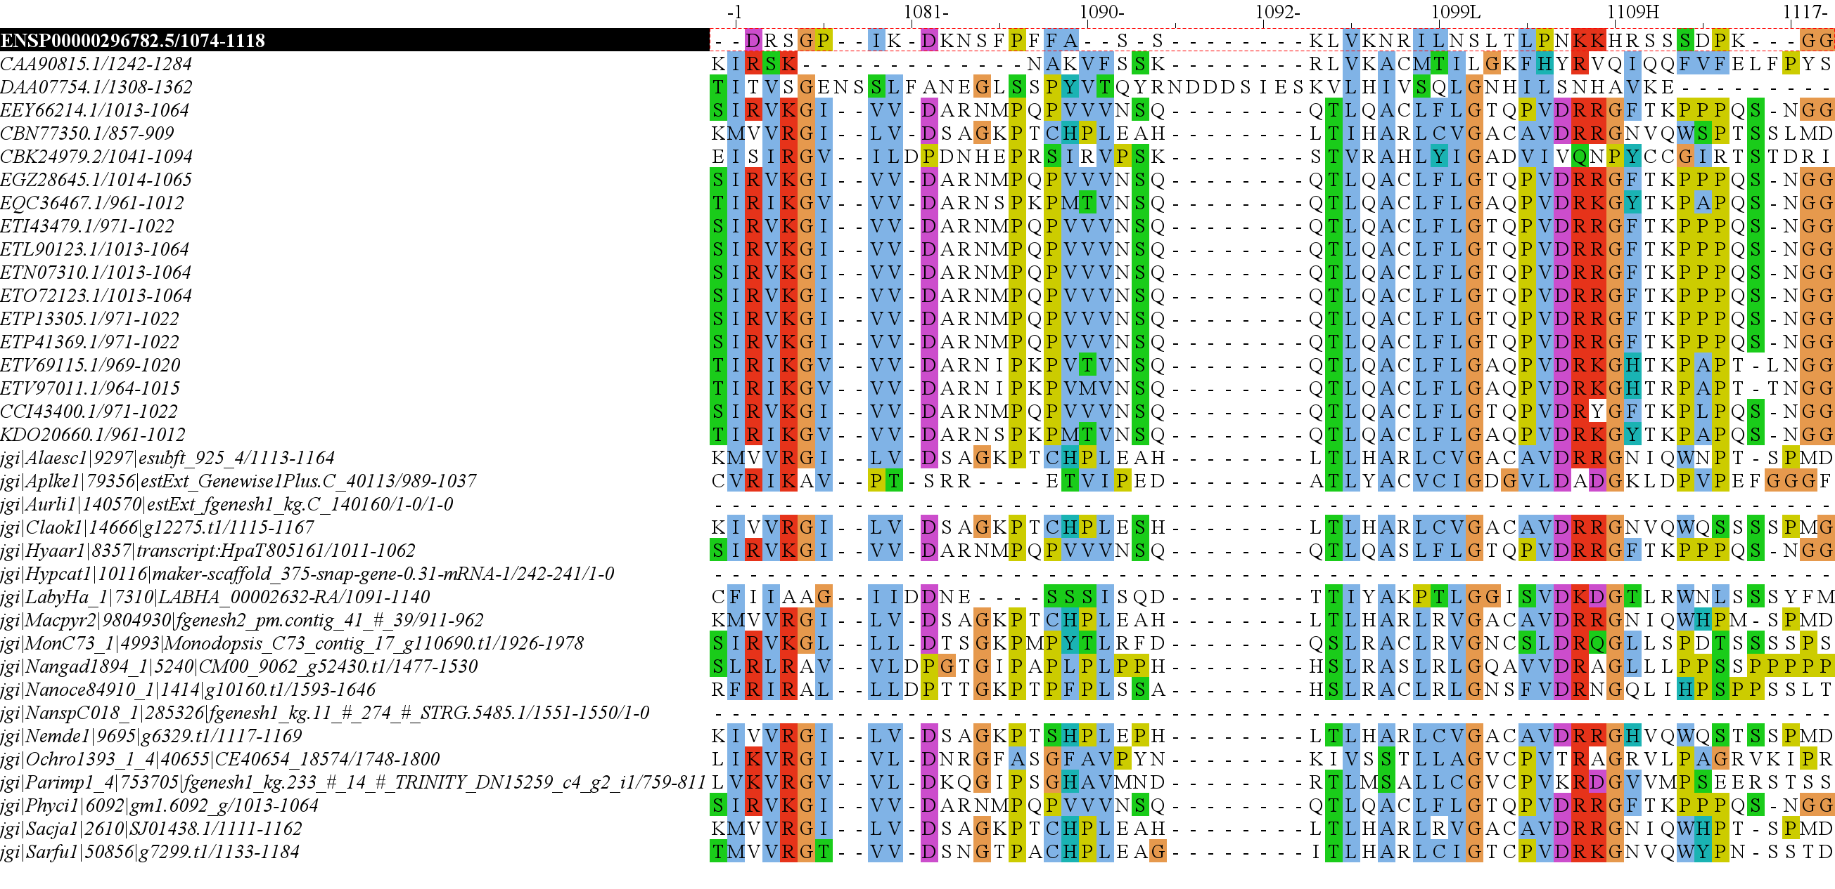
RICTOR Domain Diagram H.Sapiens Reference
57
439
743
857
1084
1190
RICTORN
RICTORM
RasGEF
Domain5
RICTOR Phosphorylation
523
742
926
992
ARM-Repeats

Slide 2
57
439
743
857
1084
1190
RICTORN
RICTORM
RasGEF
Domain5
RICTOR Phosphorylation
523
742
926
992
ARM-Repeats

Slide 3
Secondary Endosymbiosis Event
SAR
Amorphea
Archaeplastida
Ciliates
Ochrophyta
Alveolata
Apusomonada
Chlorophyta
Stramenopiles
Breviates
Streptophyta
Rhizaria
Rhodophyta
Opisthokonta
Amoebozoa
Discoba
Secondary Endosymbiosis Event
Metamonada
Euglena gracilis
Primary Endosymbiosis
Event
Excavata

Slide 4
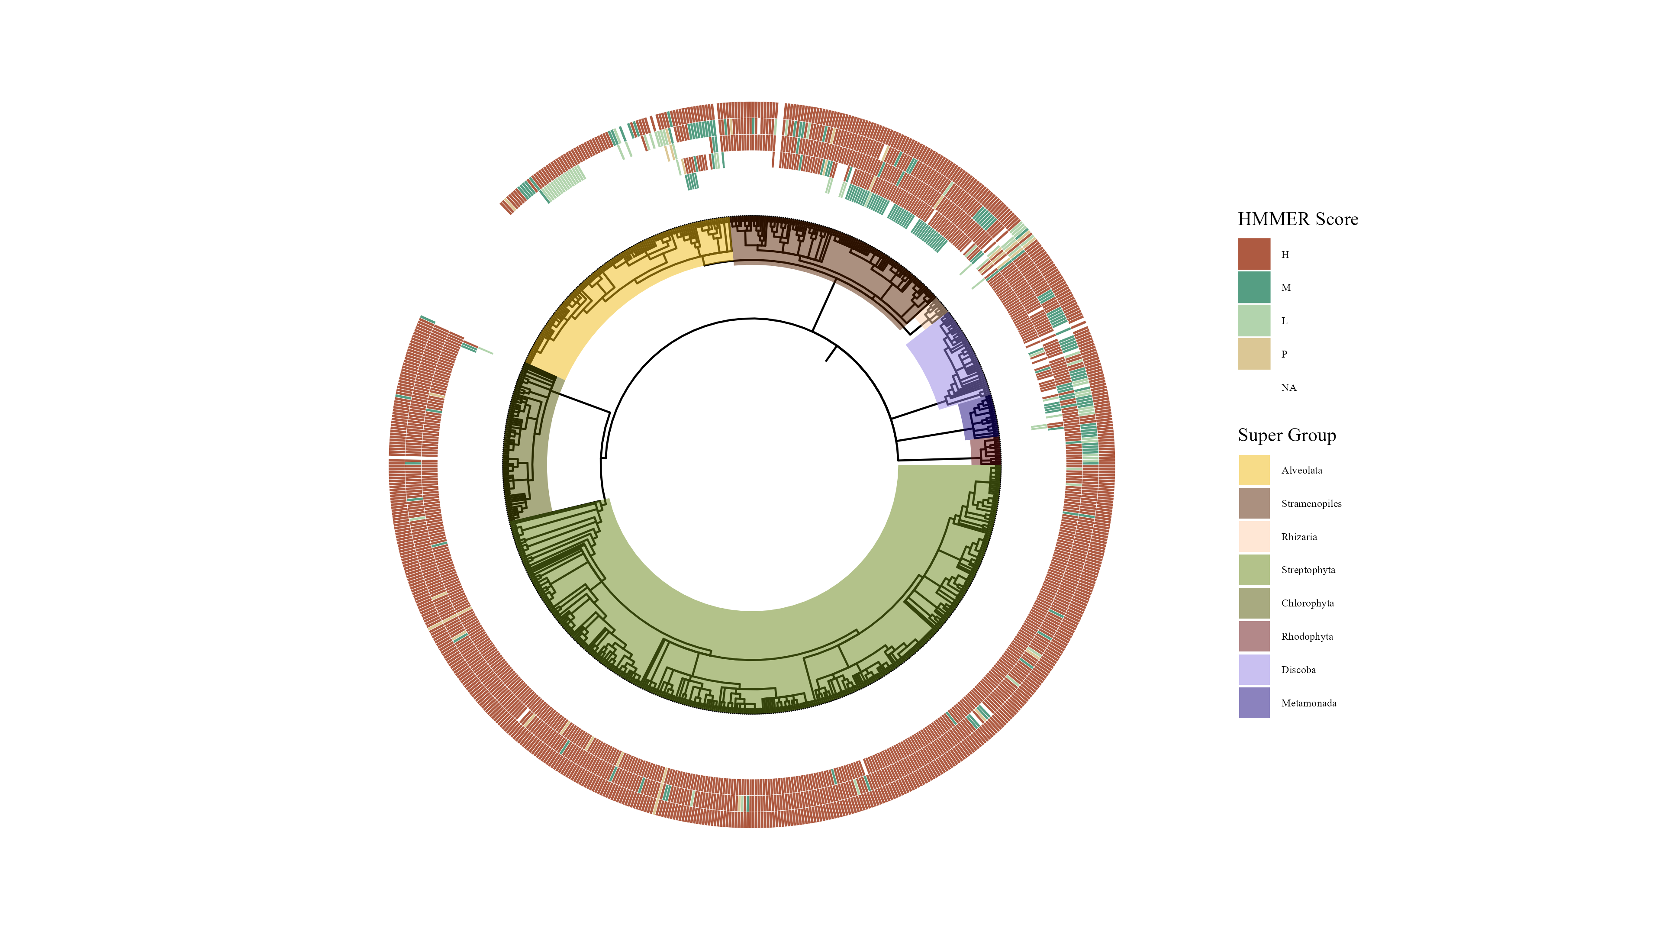

Slide 5
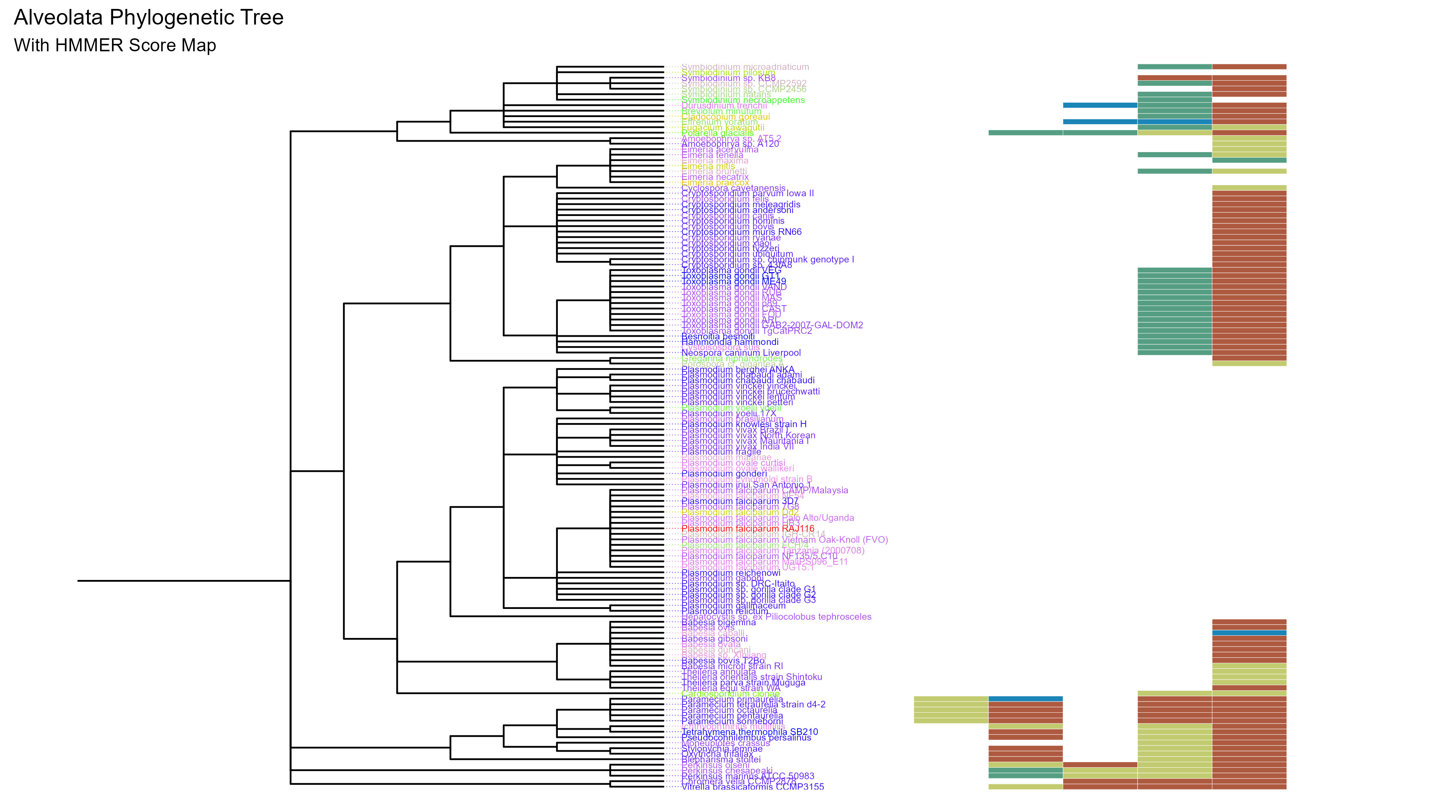
SIN1
RICTOR
RAPTOR
LST8
TOR

Slide 6
TOR Complex 1
TOR Complex 2
RICTOR
RAPTOR
TOR
SIN1
TOR
LST8
LST8

Slide 7

Metamonada
Opisthokonta
Amoebozoa
Discoba
Rhizaria
Streptophyta
Alveolata
Stramenopila
Rhodophyta
Chlorophyta

Slide 8
Workflow/Pipeline
NCBI/JGI Genomic Information
MSA
Phylogenetic Tree(s)
Results/TOR Complex Patterns
BUSCO/HMMER/BLAST
R Tables & Taxonomy Tables
Graphs/Data Table
SRA /Diamond Alignment
Notes:
We need to add a start point. Have something that asks the question; what organisms have TORC2 Components and TORC1 Components?

Slide 9
RICTORN
RICTORM
RasGEF
Domain5
RICTOR Phosphorylation
ARM Repeats

Slide 10
RAPTORN
ARM Repeats
HEAT
ARM Repeats
WD-40 Repeats

Slide 11
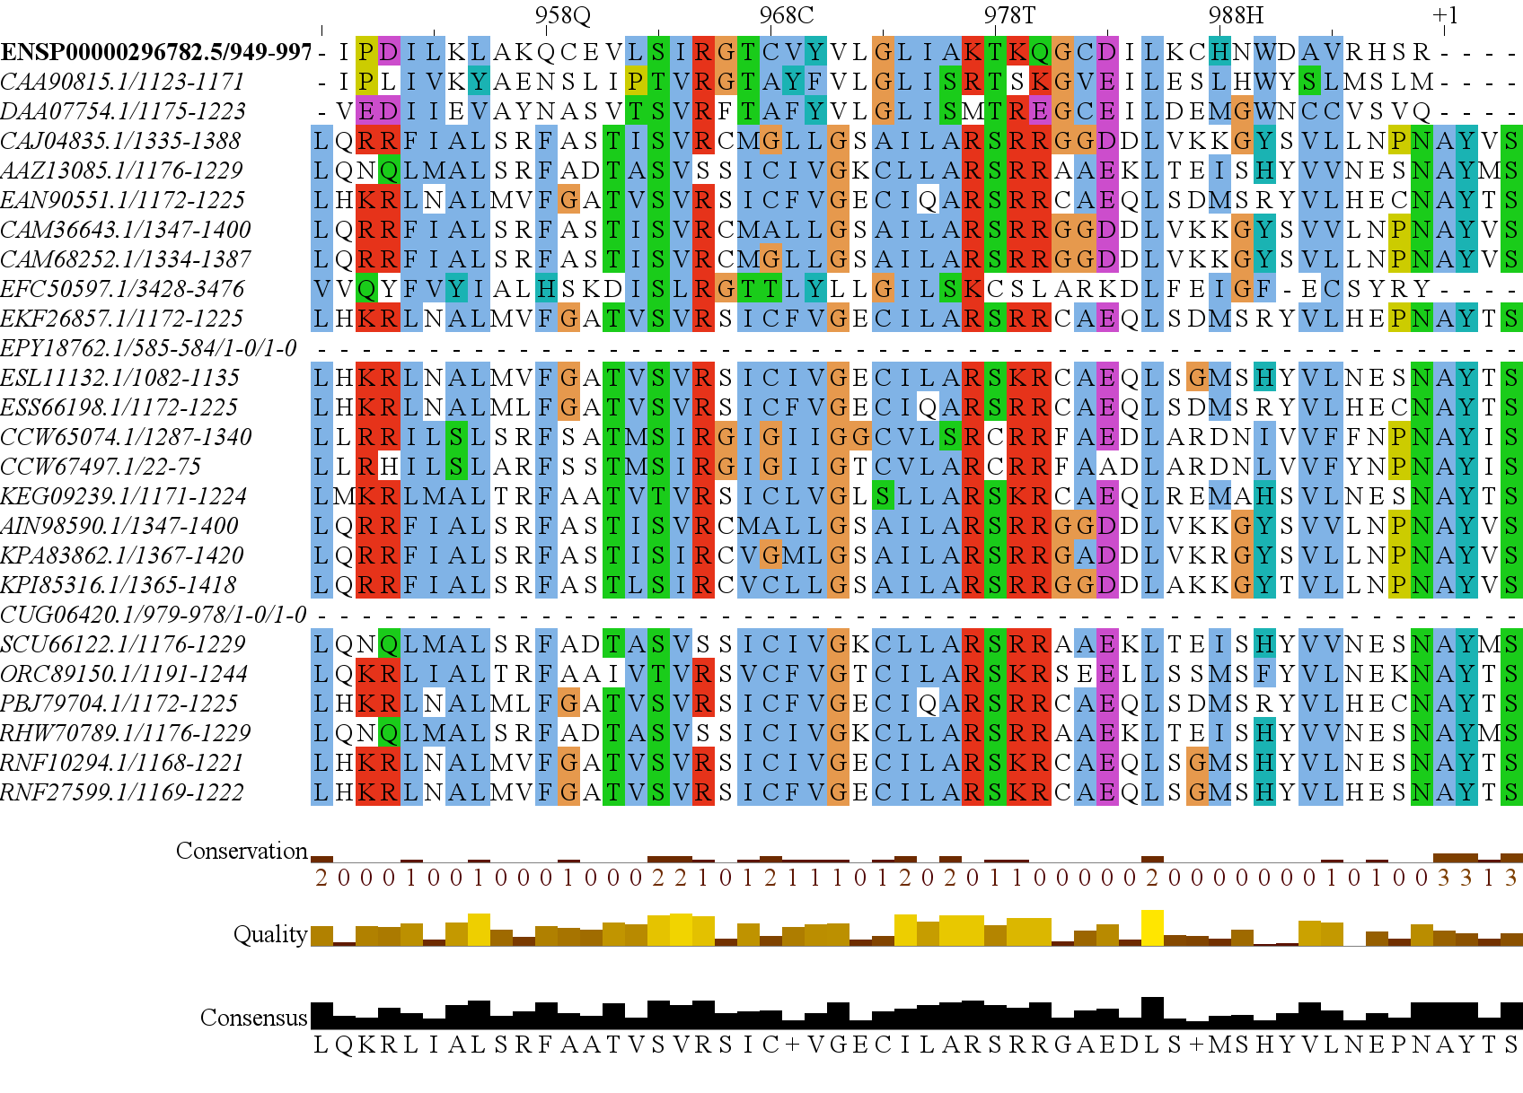
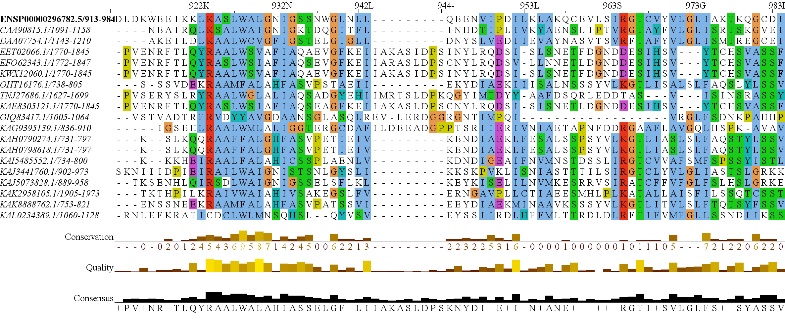

Slide 12
Stramenopile & Alveolata
Gain of Photoautotrophy
Rhodophyta Endosymbiosis
Bacillariophyta
Ochrophyta
Parmales
Eustigmatales
Stramenopila
Oomycetes, etc.
Expected Heterotrophic Ancestor
Stramenopile Endosymbiosis
Dinophyceae
Myozozoans
Apicomplexa
Alveolata
Chromera, Vitrella
Ciliates, etc.
Photoautorophy Loss

